Slide 1

COMPUTER NETWORKS
Sivaraman Eswaran Ph.D.
Department of Computer Science and Engineering

Slide 2

COMPUTER NETWORKS
Application Layer
Sivaraman Eswaran Ph.D.
Department of Computer Science and Engineering

Slide 3
COMPUTER NETWORKS
Unit – 2 Application Layer
2.1 Principles of Network Applications
2.2 Web, HTTP and HTTPS
2.3 The Domain Name System
2.4 P2P Applications
2.5 Socket Programming with TCP & UDP
2.6 Other Application Layer Protocols

Slide 4
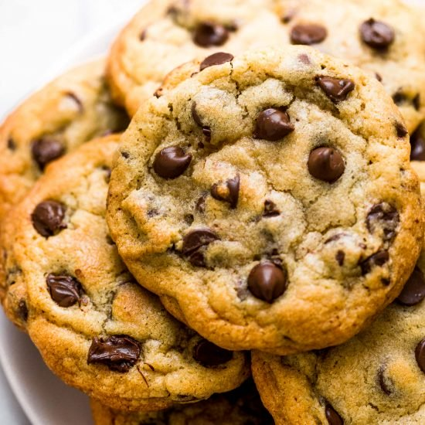
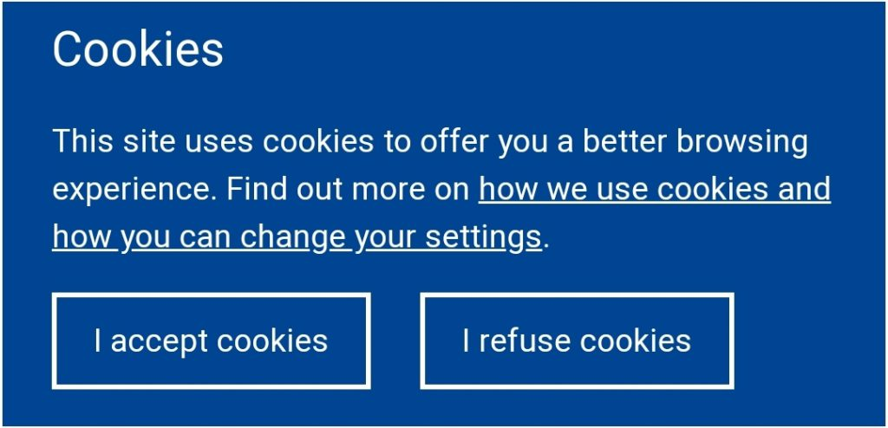
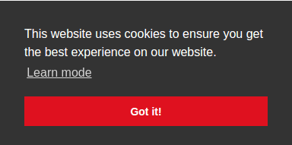
COMPUTER NETWORKS
Cookies
Website/HTTP/Internet cookies
Piece of data from a specific website
Stored on a user’s computer
Allows sites to keep track of users
Eg: language selection

Slide 5


COMPUTER NETWORKS
Maintaining user/server state: cookies
Recall: HTTP GET/response interaction is stateless
no notion of multi-step exchanges of HTTP messages to complete a Web “transaction”
no need for client/server to track “state” of multi-step exchange
all HTTP requests are independent of each other
no need for client/server to “recover” from a partially-completed-but-never-completely-completed transaction
a stateful protocol: client makes two changes to X, or none at all
X
lock data record X
X
OK
update X X’
X’
OK
t’
update X X’’
OK
X’’
unlock X
OK
X’’
time
time
Q: what happens if network connection or client crashes at t’ ?

Slide 6
COMPUTER NETWORKS
Maintaining user/server state: cookies (more)
Web sites and client browser use cookies to maintain some state between transactions
four components:
1) cookie header line of HTTP response message
2) cookie header line in next HTTP request message
3) cookie file kept on user’s host, managed by user’s browser
4) back-end database at Web site
Example:
Susan uses browser on laptop, visits specific e-commerce site for first time
when initial HTTP requests arrives at site, site creates:
unique ID (aka “cookie”)
entry in backend database for ID
subsequent HTTP requests from Susan to this site will contain cookie ID value, allowing site to “identify” Susan

Slide 7
COMPUTER NETWORKS
Maintaining user/server state: cookies (more)
client
server
ebay 8734
usual HTTP request msg
Amazon server
creates ID
1678 for user
cookie file
usual HTTP response
set-cookie: 1678
backend
database
create
entry
ebay 8734
amazon 1678
usual HTTP request msg
cookie: 1678
cookie-
specific
action
access
usual HTTP response msg
one week later:
access
ebay 8734
amazon 1678
usual HTTP request msg
cookie: 1678
cookie-
specific
action
usual HTTP response msg
time
time

Slide 8
COMPUTER NETWORKS
HTTP Cookies: Comments
What cookies can be used for:
track user’s browsing history
remembering login details
track visitor count
shopping carts
recommendations
save coupon codes for you
aside
cookies and privacy:
cookies permit sites to learn a lot about you on their site.
third party persistent cookies (tracking cookies) allow common identity (cookie value) to be tracked across multiple web sites
Challenge: How to keep state:
protocol endpoints: maintain state at sender/receiver over multiple transactions
cookies: HTTP messages carry state

Slide 9
THANK YOU
Sivaraman Eswaran Ph.D.
Department of Computer Science and Engineering
sivaramane@pes.edu
+91 80 6666 3333 Extn 834

